Slide 1
Higher Education Case Study
Average College Tuition on the Rise in the USA

Slide 2
The synopsis
Story
Datasets
Problem statement
How much has tuition increased?
Where is the greatest disparity between public and private tuition?
Which state has the best deal on in-state or out-of-state tuition?
National Center for Education Statistics
Public vs. Private
In-state vs. Out-of-state
4-year vs. 2-year
Convert CSV to geoJSON and SQLite
Enable layers in our choropleth leaflet map
Connect line and bar charts to select dropdown by state

Slide 3
Challenges deep-dive
Challenge 1
Challenge 2
Challenge 3
Join datasets
Adding tables together with mySQL and GeoJSON data
Create map layers
Write function for separate layers for each type of tuition
Select dropdown for each state
Set up SQLite database
Convert all data to one SQLite database with RebaseData.com and prepare it all for Heroku

Slide 4
Solution
Used leaflet to map and added polylines for hover over each state
Use Plotly for bar charts, GeoJSON formatted data for heat map and choropleth

Slide 5
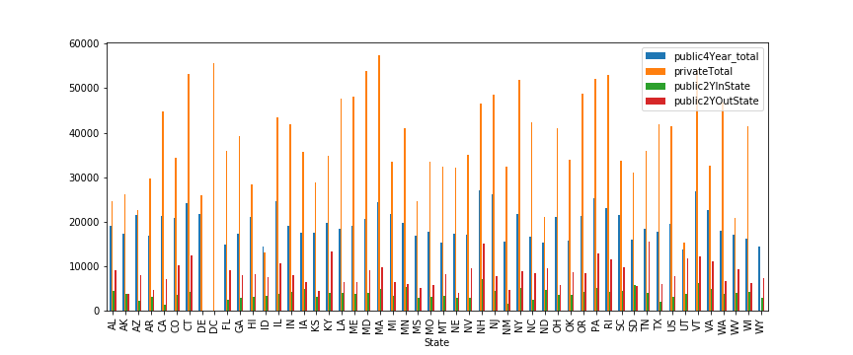
Heroku App Link

Slide 6
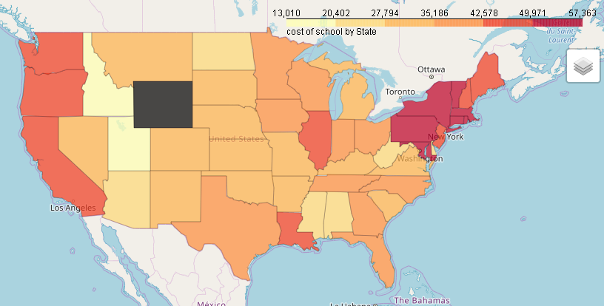
College tuition for private universities 2017

Slide 7
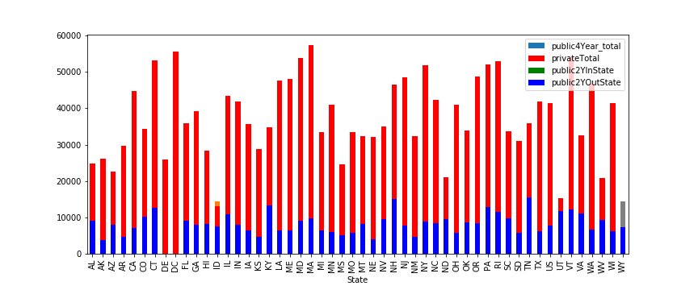
Average public tuition has increased 1.5x since ‘94
DC has greatest disparity between public and private tuition
Alaska has the same in-state and out-of-state tuition for 2 year programs

Slide 8
Technologies

Slide 9
TopoJSON (compact), cartogram.js: http://prag.ma/code/d3-cartogram/?#popchange/2011
Pandas, SQLAlchemy, Plotly, Folium, Seaborn,JSON
HTML, CSS, Bootstrap, Deploy to Heroku
Python
mySQL
Leaflet
D3.js
Flask
Workbench, dbForge Studio, RebaseData converter, DB Browser for SQLite
Read in JSONified data and arrange plots

Slide 10
Changes for further research
Filter by room and board, books, loans, etc.
Cost calculator for projected increase in tuition

Slide 11
The Team
Data wrangler
Visualizer
Dashboard Designer
Lissette Toledo
Chris Irabor
Victor Yamaykin

